Slide 1
Rhetorical Appeals
& The Art of Rhetoric

Slide 2
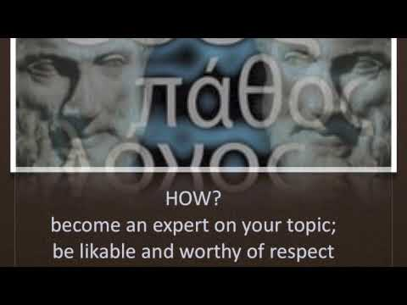
Take Notes:
Define
Logos
Pathos
Ethos

Slide 3
Logos
Facts & Statistics
Logic ("If..... then...")
  Cause and Effect Relationships
  Compare and Contrast
  Problem and Solution

Slide 4
Pathos
Figurative Language
Heated/Emotional Language
Descriptive Writing

Slide 5
Ethos
Where the author refers to sources
Where the author draws from personal experience
Where & how counter argument is addressed

Slide 6
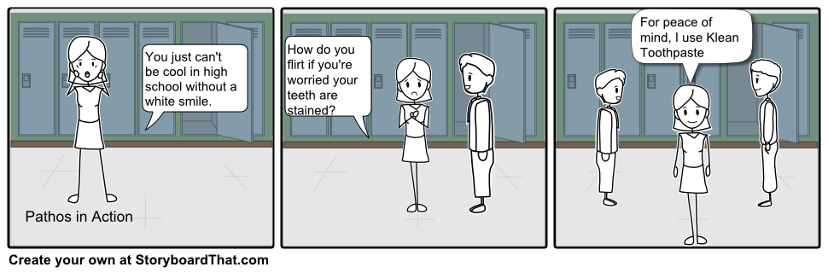
Which appeal is being used?

Slide 7
Pathos
How is this ad trying to make you feel?
Pathos is the appeal to our emotions. A successful appeal to our emotions makes us feel something in hopes of making us want to act on that feeling.

Slide 8
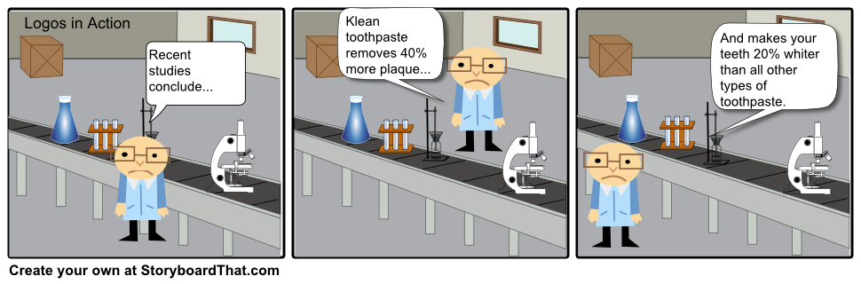
Which appeal is being used?

Slide 9
LOGOS
How does this strip guide our reasoning?
Logos is the appeal to logic. When persuading, this technique appeals to your audience’s ability to reason by using facts and logic to guide your thought process.

Slide 10
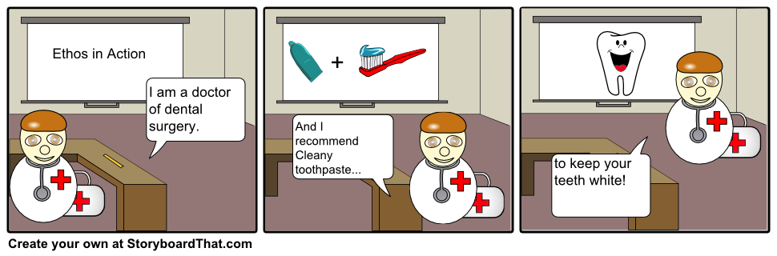
Which appeal is being used?

Slide 11
ETHOS
Why should you trust this information?
Ethos is the appeal to the credibility of the speaker. Essentially, it answers the question, “Why should I trust or believe YOU?”

